Slide 1
CSCI578 Project
Team Member:
Shuqi Xiao
Zhichun Xuan
https://github.com/davidxuan/project

Slide 2
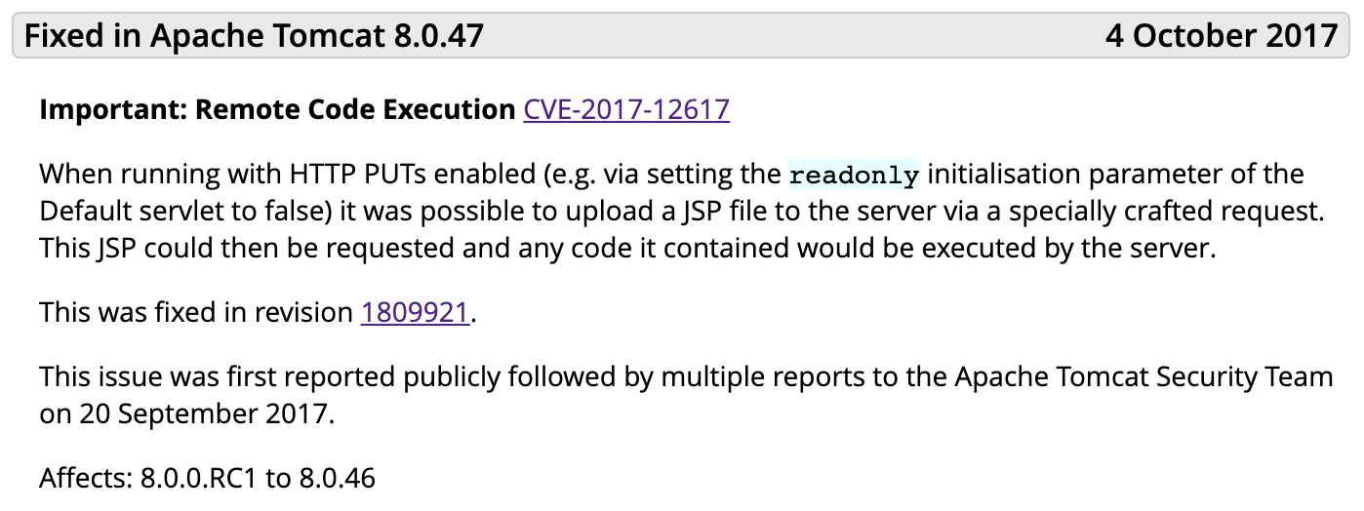
Security-related Architecture Decision
Subject System: Tomcat
Vulnerability: CVE-2017-12617

Slide 3
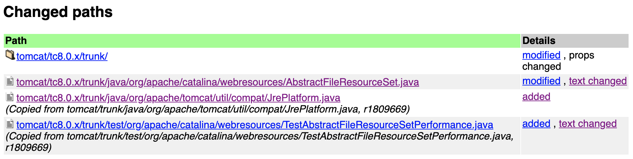
Security-related Architecture Decision
Log Message:
- Add some additional checks required on Windows to keep all the checks in one place and to avoid exceptions later in the processing.
- Includes utility class to determine if platform is Windows and performance test case for alternative implementations.
Subject System: Tomcat
Vulnerability: CVE-2017-12617
Revision: 1809921

Slide 4
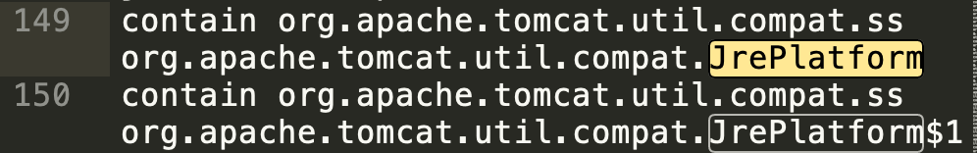
ACDC: An Algorithm for Comprehension-Driven Clustering
Run ACDC with Tomcat 8.0.47
In apache-tomcat-8.0.47_acdc_ clustered.rsf, the two files related to the architecture decision did not clustered into one cluster.
Even though AbstractFileResourceSet depends on JrePlatform.

Slide 5
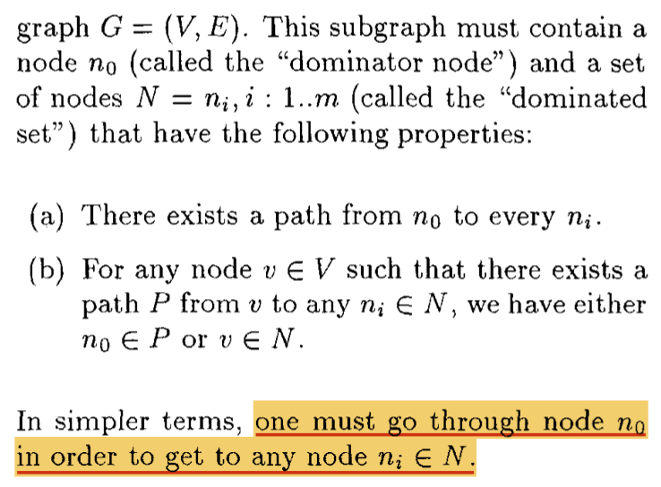
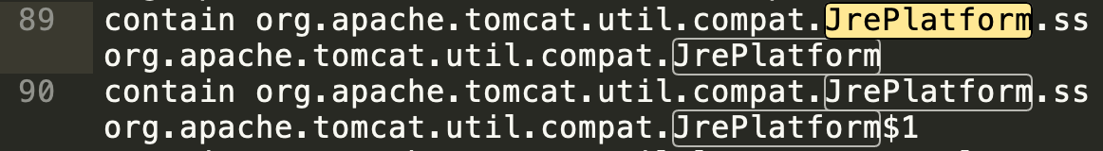
ACDC: An Algorithm for Comprehension-Driven Clustering
AbstractFileResourceSet need to be the dominator node if JrePlatform is in the same cluster with it.
Modified SubGraph.java to find dominator node of their clusters.
However, we cannot get to JrePlatform by going through StandardRoot. Therefore, JrePlatform does not clustered in xxx.webresources.ss.
Reference:
Tzerpos, Vassilios, and Richard C. Holt. "Acdc: an algorithm for comprehension-driven clustering." Proceedings Seventh Working Conference on Reverse Engineering. IEEE, 2000.

Slide 6
Modify ACDC Add a New Pattern “Attach”
This pattern clusters files A and B together in such case: Ignore (anonymous) inner classes, file A is depended and is only depended by file B.
Add Attach.java. we traverse to find file that is only depended by one other file, than attach it to its source.
Ignore sources that are its (anonymous) inner classes, file A is only depended by one other file if it only has one source;
We can find file B via the only one source;
Create a new cluster node, which will contain fila A and file B;
Add the new cluster node under the parent of file B;
Make file A and file B as children of the new cluster node.

Slide 7
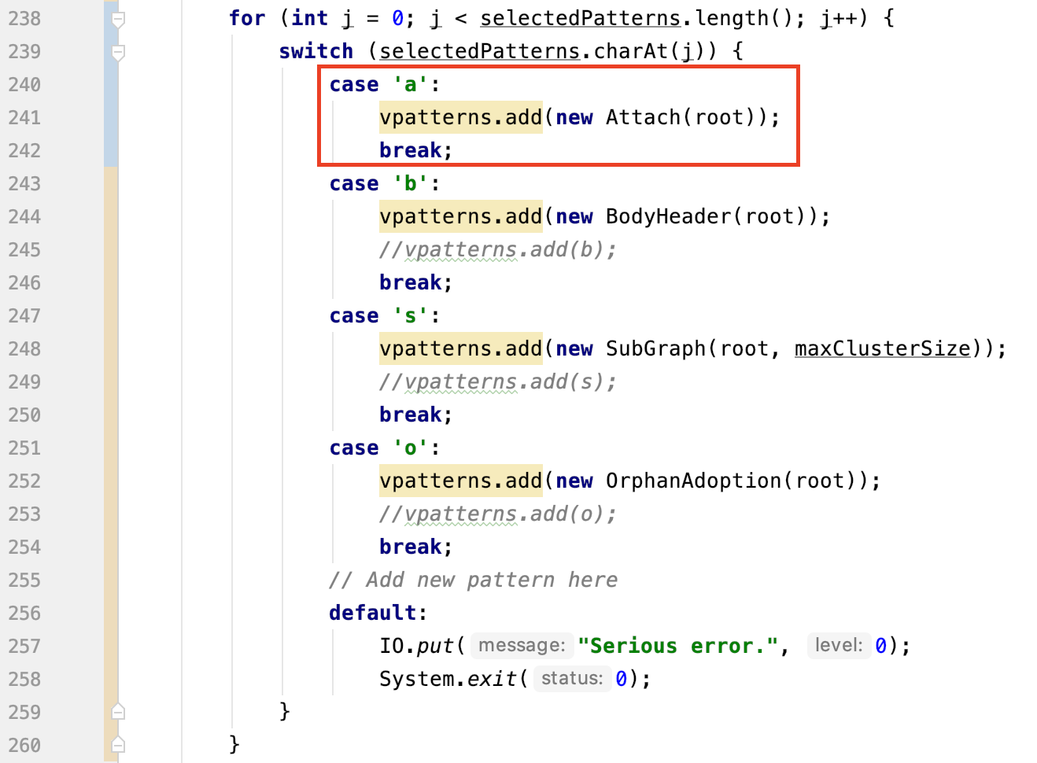
Modify ACDC Add a New Pattern “Attach”
Modify ACDC.java
Define default patterns as
Attach – Subgraph - OrphanAdoption

Slide 8
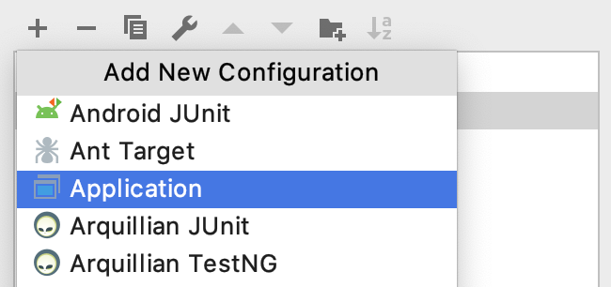
Run our prototype in Intellij IDEA
Add a new configuration, choose Application.

Slide 9
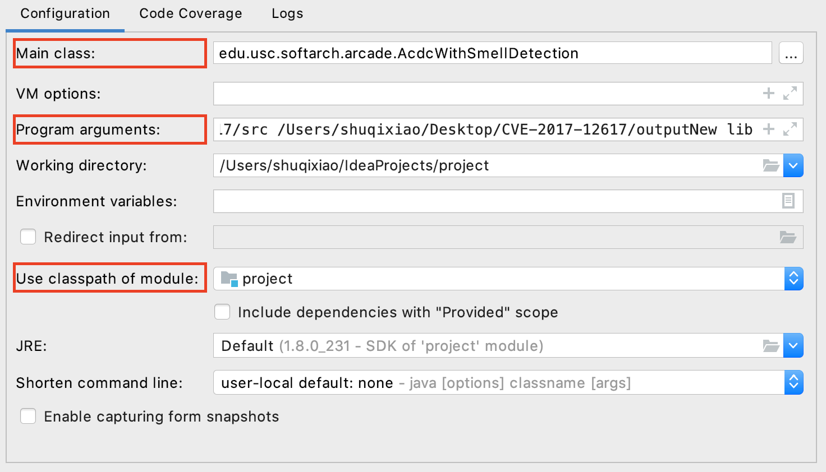
Run our prototype in Intellij IDEA
Choose Main Class and Use classpath of module.
Fill the Program arguments
(inputPath OutputPath ClassDirName)
e.g. /Users/shuqixiao/Desktop/CVE-2017-12617/src /Users/shuqixiao/Desktop/CVE-2017-12617/outputNew lib

Slide 10

Run our prototype in Intellij IDEA
Click Apply -> OK to save the new configuration
Click the run button (on the right) and wait.

Slide 11
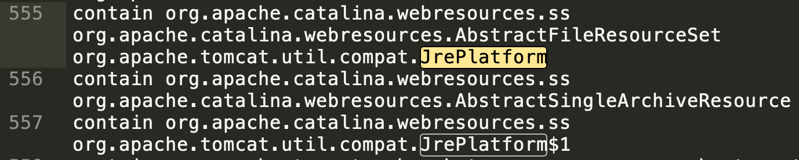
Result
In cluster org.apache.Catalina.webresources.ss, we have
org.apache.catalina.webresources.AbstractFileResourceSet
org.apache.tomcat.util.compat.JrePlatform
Now two files related to the architecture decision are clustered together.

Slide 12
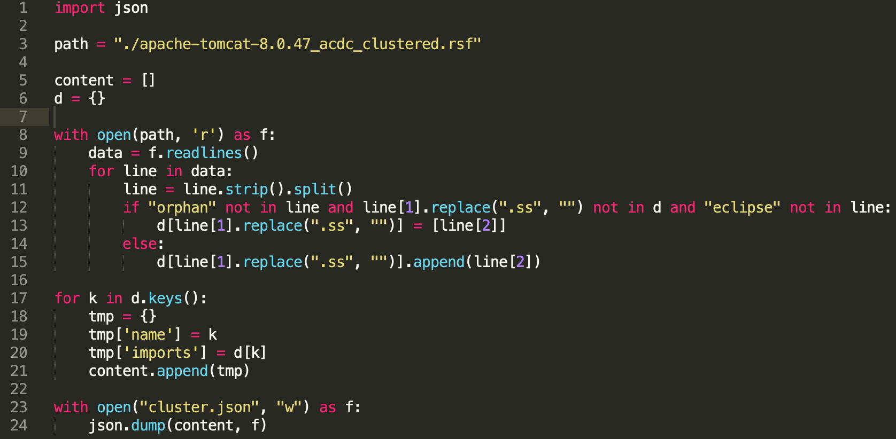
Visualization with D3.js
parse_output.py: Delete those orphan and eclipse nodes, drop the suffix “ss” for cluster.
Line 3 is the path of clustered.rsf.

Slide 13
Visualization with D3.js
Use command python parse_output.py to generate a json file.
Fork https://observablehq.com/@d3/chord-dependency-diagram
Upload the cluster.json file.
Then we can see those clusters and dependencies among them.

Slide 14
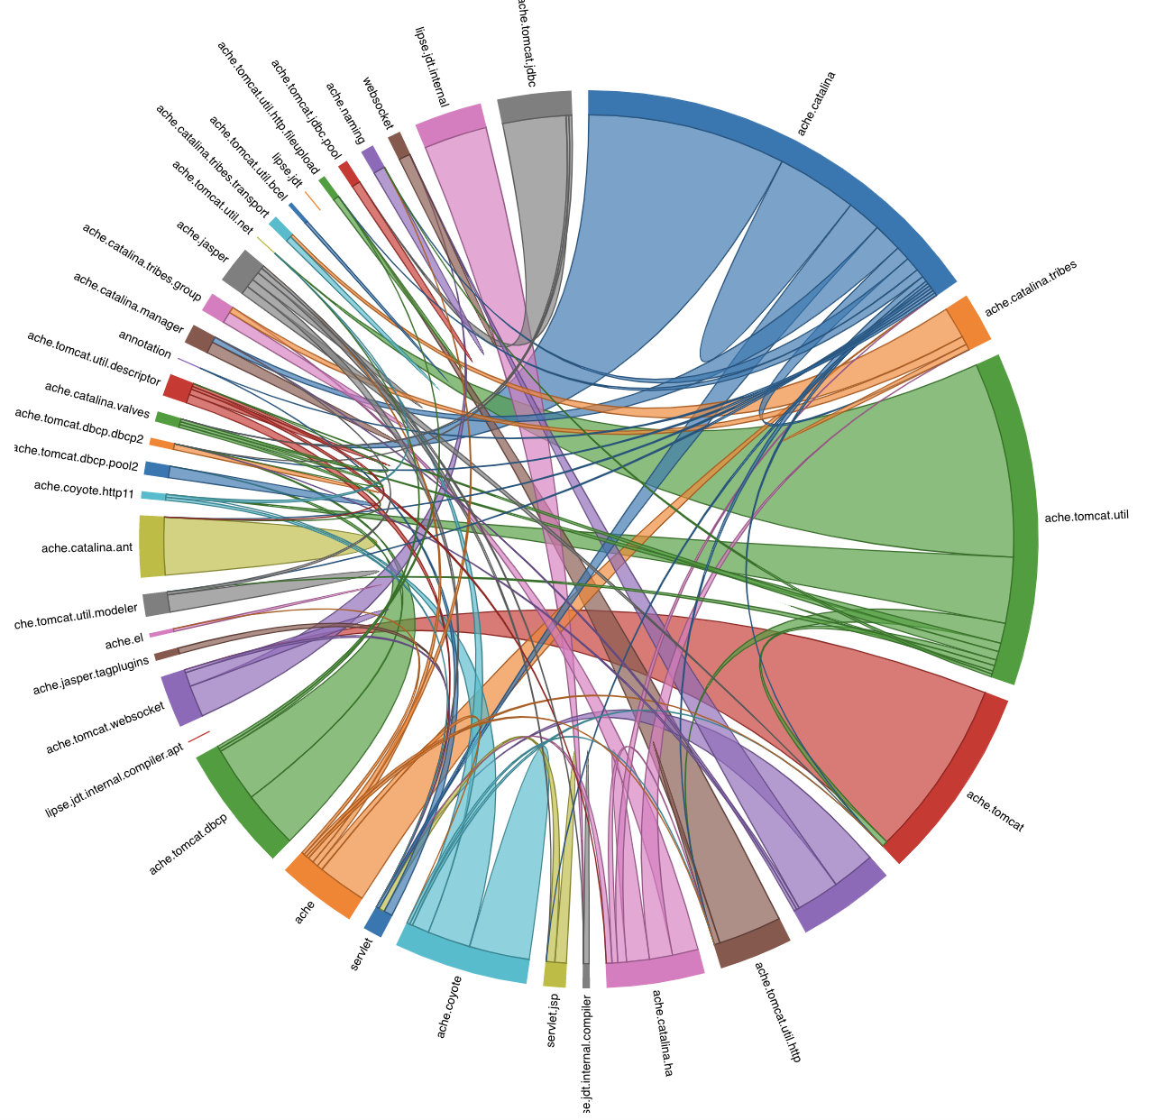
Visualization with D3.js

